Slide 1
Data Structures and Algorithms -3 (25CS2103E)
Title of the project
Edmonds–Karp Maximum Flow Visualization Using Breadth-First Search
Team Members
Y. Uttej - 2520030439
G. Hitesh - 2520030370
K. Sudheer - 2520030470
Under the Esteemed Guidance of
Guide: Mrs. J Yamini Devi
Name of the DSA-3 faculty name with designation and department

Slide 3
Contents
Abstract
Introduction
Literature survey
Problem Statement and Objectives
Hardware and Software requirements
Results
Conclusion
Future Scope

Slide 4
Abstract
The Edmonds–Karp algorithm is a well-known method for solving the Maximum Flow problem in a flow network. It is an implementation of the Ford–Fulkerson method that uses Breadth-First Search (BFS) to find augmenting paths. This project develops an application that demonstrates the working of the Edmonds–Karp algorithm in an interactive and understandable manner. The system displays the selected augmenting path during each iteration, calculates the bottleneck capacity, updates the residual graph, and visually represents the changes in the network. The application continues until no further augmenting path exists, after which thefinal maximum flow value is displayed. This visualization helps users understand how BFS is used to compute maximum flow and how residual capacities change during the execution of the algorithm.
The system also focuses on improving the learning experience by presenting the algorithm's execution in a clear, step-by-step manner. Instead of showing only the final maximum flow, it records the sequence of augmenting paths, the flow added in each iteration, and the corresponding changes in residual capacities. This allows users to observe how available paths gradually become saturated and how reverse edges enable flow adjustments. The visualization provides a practical understanding of the Edmonds–Karp algorithm and demonstrates how BFS systematically leads the network toward the maximum possible flow.

Slide 5
Introduction
The Maximum Flow problem is an important problem in graph theory and computer science. It involves finding
the maximum possible amount of flow that can be transferred from a source vertex to a sink vertex in a directed
network, while satisfying the capacity constraints of every edge.
The Edmonds–Karp algorithm solves this problem by repeatedly using BFS to find the shortest augmenting path fromthe source to the sink in terms of the number of edges. Once a path is found, the algorithm determines its minimum residual capacity, known as the bottleneck capacity, and increases the flow along that path.
After every augmentation, the residual graph is updated. When BFS can no longer find a path from the source to the sink, the algorithm terminates and the accumulated flow represents the maximum flow.
The proposed application makes these steps visible so that students can easily understand the relationship between BFS, augmenting paths, residual graphs, and maximum flow.

Slide 6
Literature Survey
Author/Concept | Description
Ford–Fulkerson Method | Provides the basic approach for solving the Maximum Flow problem by repeatedly finding augmenting paths.
Edmonds and Karp | Improved the Ford–Fulkerson approach by selecting augmenting paths using BFS, providing a polynomial-time algorithm.
Breadth-First Search | Traverses a graph level by level and is used by Edmonds–Karp to identify augmenting paths.
Residual Graph | Represents the remaining available capacity and reverse-flow possibilities after each flow update.
Graph Visualization | Interactive visualization techniques help learners understand graph algorithms by showing their intermediate execution steps.
Existing implementations generally focus on calculating the final maximum flow. However, beginners may find it difficult to understand how each augmenting path changes the residual graph. The proposed system addresses this by displaying every iteration and its corresponding graph updates.

Slide 7
Problem Statement and Objectives
Problem Statement
Develop an application to implement the Edmonds–Karp algorithm for solving the Maximum Flow problem using
Breadth-First Search (BFS). The application should display each augmenting path selected during execution, calculate the flow added through the path, and update the residual graph after every iteration. It should provide visualization of intermediate steps and finally report the maximum flow value, helping users understand the complete BFS-based flow computation process.
Objectives
The main objectives of the project are:
To implement the Edmonds–Karp Maximum Flow algorithm.
To use BFS for finding augmenting paths.
To display each augmenting path selected during execution.
To calculate the bottleneck capacity of every augmenting path.
To update and display the residual graph after each iteration.
To visualize the intermediate stages of the algorithm.
To calculate and display the final maximum flow.
To provide an educational tool for understanding Maximum Flow algorithms.

Slide 8
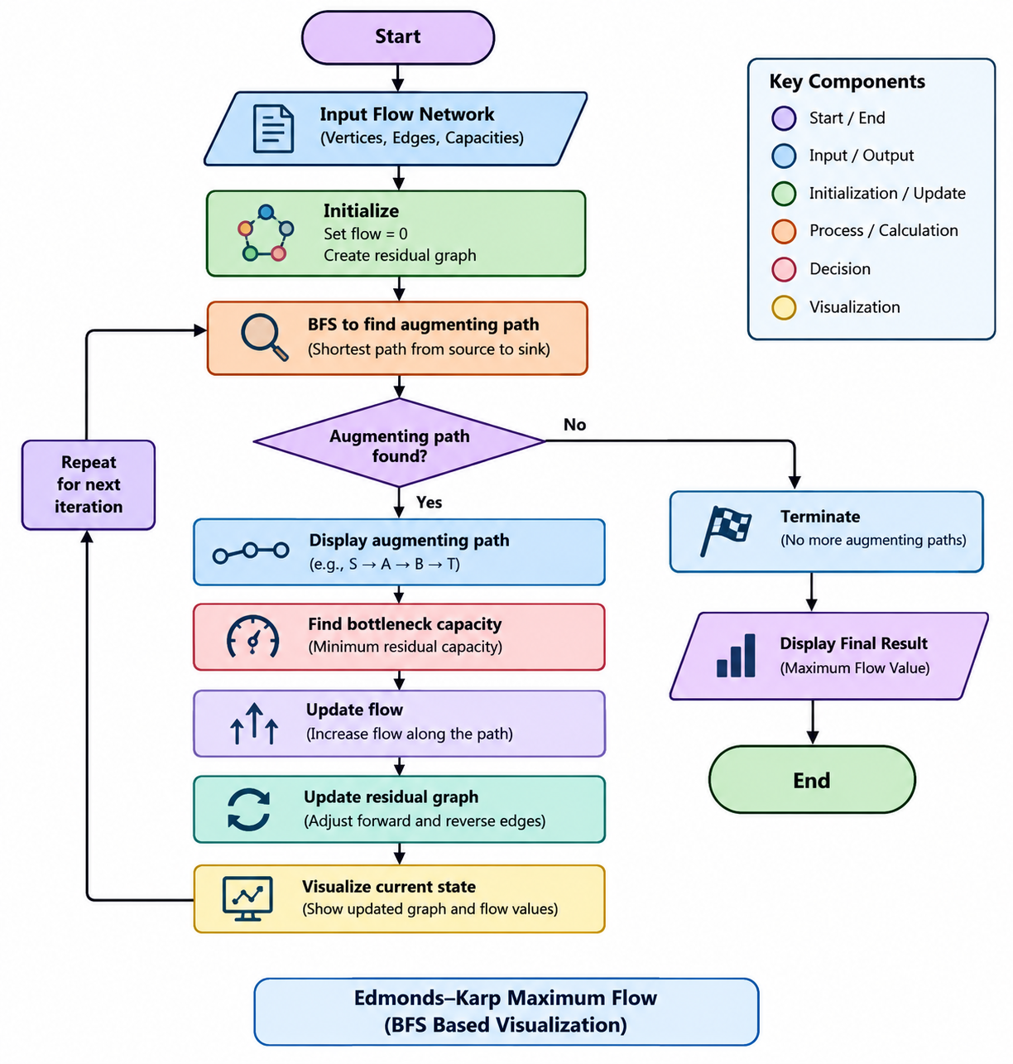
Flow Chart

Slide 9
Results
The developed application successfully demonstrates the execution of the Edmonds–Karp algorithm using BFS.
The system:
Accepts a flow network containing vertices, edges, and capacities.
Identifies an augmenting path using BFS.
Displays the selected augmenting path.
Determines the bottleneck capacity.
Increases the flow along the selected path.
Updates the residual capacities.
Displays the updated residual graph after each iteration.
Repeats the process until no augmenting path remains.
Displays the final maximum flow value.

Slide 10
Hardware and Software requirements
Hardware Requirements
Processor: Intel Core i3 or equivalent
RAM: Minimum 4 GB
Storage: Minimum 500 MB free space
Display: Standard monitor
Keyboard and Mouse: Required for user interaction
Software Requirements
Operating System: Windows / Linux / Ubuntu
Programming Language: Java
IDE: Visual Studio Code / IntelliJ IDEA / Eclipse
JDK: Java Development Kit 8 or above
Graph Visualization: Java Swing/JavaFX or suitable graph visualization library
Version Control: Git and GitHub
Browser: Google Chrome / Microsoft Edge, if a web-based interface is used

Slide 11
Conclusion
The Edmonds–Karp Maximum Flow Visualization System successfully implements the Edmonds–Karp algorithm using Breadth-First Search. The application demonstrates how augmenting paths are selected, how bottleneck capacities determine the amount of additional flow, and how the residual graph changes after every iteration.
By visualizing each intermediate step, the system makes the Maximum Flow problem easier to understand compared with a program that only produces the final result. It can therefore serve as an effective educational tool for students learning Graph Algorithms, BFS, Network Flow, and Algorithm Analysis.

Slide 12
Future Scope
The project can be enhanced in the following ways:
Interactive Graph Creation – Allow users to add, remove, and connect vertices and edges interactively.
Step-by-Step Controls – Provide Next, Previous, Play, and Pause buttons for algorithm execution.
Multiple Algorithms – Add Ford–Fulkerson, Dinic's Algorithm, and Push-Relabel algorithms for comparison.
Performance Analysis – Display the number of BFS operations, iterations, and execution time.
Improved Visualization – Use animations to show flow movement and residual-capacity changes.
Graph File Support – Allow users to import and export flow networks.
Educational Mode – Provide explanations of BFS, residual graphs, bottleneck capacity, and augmenting paths at each step.
Web-Based Version – Develop a browser-based version so that students can access the visualization without installing software.
Real-World Applications – Extend the system to demonstrate applications such as transportation networks, communication networks, and resource allocation.
Comparison Dashboard – Compare the performance and number of iterations of different maximum-flow algorithms.

Slide 13
Thank you

